Slide 1
Optimizing Apache Spark
The Five Most Common Performance Problems
Skew

Slide 2
The 5 Most Common Performance Problems (The 5 Ss)
Skew
Data is typically read in as 128 MB partitions and evenly distributed ...more on maxPartitionBytes later
As the data is transformed (e.g. aggregated), it’s possible to have significantly more records in one partition than another
A small amount of skew is ignorable
But large skews can result in spill or worse, hard to diagnose OOM Errors

Slide 3
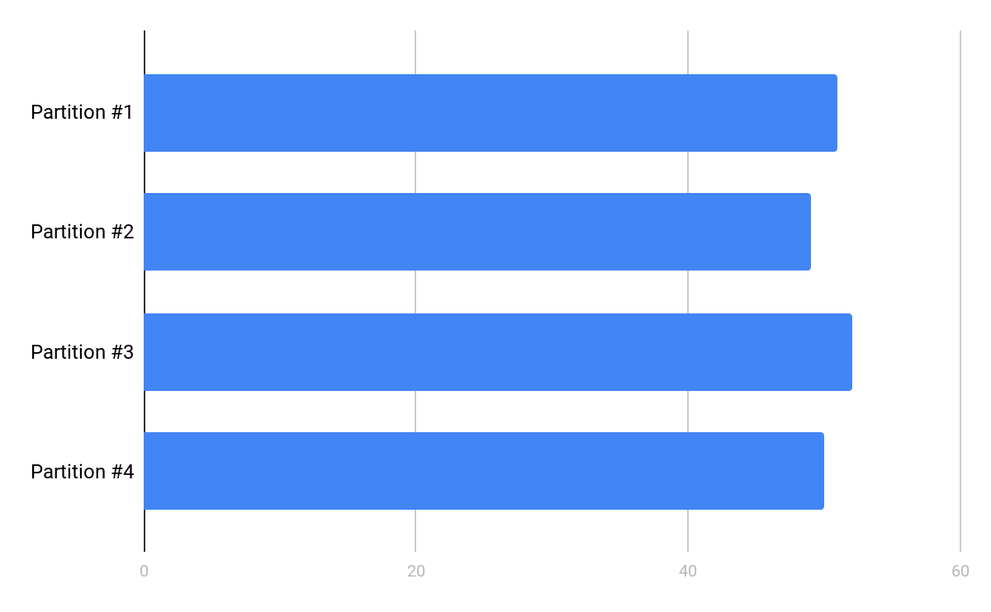
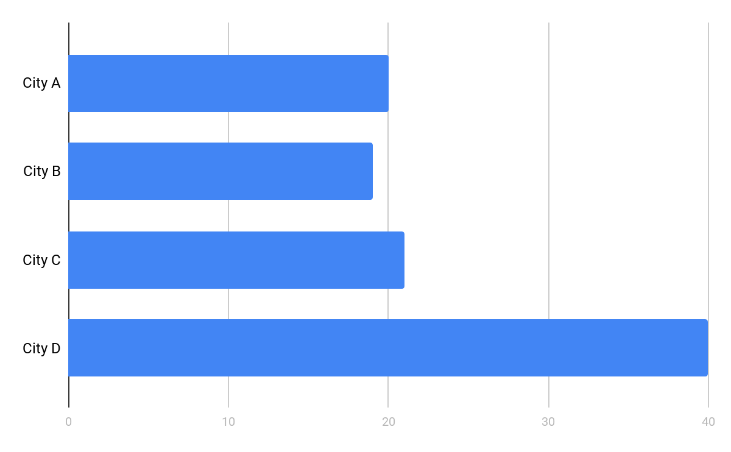
The 5 Most Common Performance Problems (The 5 Ss)
Skew - Before & After
Before aggregation After aggregation by city
Notes:
In this example, we have 4 partitions
They should be evenly distributed after the initial ingest by Spark.
City A, B, and C might be similar IF the data is correlated around something like population. The assumption here is that cities A, B and C are the same size.
But city D has twice the population, thus twice as many records
Who knows what cities E-ZZZ might look like - it doesn't matter for this illustration.

Slide 4
The 5 Most Common Performance Problems (The 5 Ss)
Skew - Ramifications
If City D is 2x larger than A, B or C…
It takes 2x as long to process
It requires 2x as much RAM
The ramifications of that is...
The entire stage will take as long as the longest running task
We may not have enough RAM for these skewed partitions
After aggregation by city
Notes:
Once aggregated around the city, we can expect that the partition containing D will be proportionally larger than our other three cities.
A larger partition means it has more records. More records means it will take Spark longer to process that partition.
In our example here, it can take Spark twice as long to process City D as it would take to process A, B or C.

Slide 5
What can we do to mitigate skew?
What can we do to mitigate skew?
Notes:
Let the students speculate !!!

Slide 6
The 5 Most Common Performance Problems (The 5 Ss)
Skew - Time vs RAM
We need to first ask which problem are we solving for?
Solving for the RAM problem is only treating the symptoms and not the root cause.
The RAM problem manifests itself as Spill and/or OOM Errors and should not be the first thing we solve for...more on spill later
The first problem to solve for is the uneven distribution of records across all partitions which manifests itself as proportionally slower tasks

Slide 7
The 5 Most Common Performance Problems (The 5 Ss)
Skew - Mitigation
There are several strategies for fixing skew:
Employ a Databricks-specific skew hint (see Skew Join optimization)
Enable Adaptive Query Execution in Spark 3
...more on AQE and Spark 3 later
Salt the skewed column with a random number creating better distribution across each partition at the cost of extra processing

Slide 8
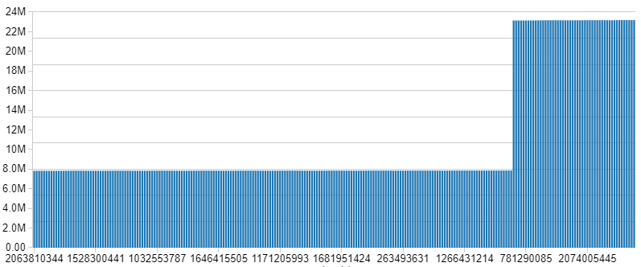
The 5 Most Common Performance Problems (The 5 Ss)
Skew - How Skewed?
See Experiment #1596, Step B
Our perfectly engineered data has a skew in US cities that is ~3x larger than all other countries
Counts come in at 23 million for skewed cities vs 8 million for other cities
As we will see, you really need to know your data to solve for this...maybe not with AQE, but more on AQE later
Notes:
AQE actually allows us to solve for this problem without knowing the data.

Slide 9
The 5 Most Common Performance Problems (The 5 Ss)
Skew - Baseline vs Hint
See Experiment #1596, Step C and Step D
Contrast the last stage of the last job for the two commands
Note the key code differences
Note the total execution time of the corresponding commands
Note the total number of tasks
In the Spark UI, Stage Details
Note the “health” of the stage as seen in the Event Timeline
Note the min/median/max Shuffle Read Size under Summary Metrics
Note the total amount of spill under Aggregated Metrics by Executor
Notes:
We go deeper on Spill later, for now just have them capture the metric with nothing more than a 10 second explination

Slide 10
The 5 Most Common Performance Problems (The 5 Ss)
Skew - Baseline vs Hint, Review
Step | Code | Duration | Tasks | Health | Shuffle | Spill
C | Standard | ~30 min | 832 | Bad | 0 / 0 / ~100 KB / ~400 MB / ~3 GB | ~50 GB
D | Skew Hint | ~35 min | 832 | Mostly OK | 134 MB / 174 MB / 184 MB / 195 MB / 1.1 GB | ~4 GB
This scenario introduces the Databricks-specific skew hint (see Skew Join optimization)
Note the call .hint(“skew”, “city_id”)
Notes:
Our example shows the hint being slower. And while that is sometimes the case, the key thing to call out is that it’s also more stable.
Without spill and potential OOMs, we can better guarantee that the job will complete.

Slide 11
The 5 Most Common Performance Problems (The 5 Ss)
Skew - Baseline vs Hint vs w/AQE
See Experiment #1596, Step E with Step C and Step D
Contrast the last stage of the last job for the two commands
Note the key code differences
Note the total execution time of the corresponding commands
Note the total number of tasks
In the Spark UI, Stage Details
Note the “health” of the stage as seen in the Event Timeline
Note the min/median/max Shuffle Read Size under Summary Metrics
Note the total amount of spill under Aggregated Metrics by Executor

Slide 12
The 5 Most Common Performance Problems (The 5 Ss)
Skew - Baseline vs Hint, Review
Step | Code | Duration | Tasks | Health | Shuffle | Spill
C | Standard | ~30 min | 832 | Bad | 0 / 0 / ~100 KB / ~400 MB / ~3 GB | ~50 GB
D | Skew Hint | ~35 min | 832 | Mostly OK | ~135 MB / ~175 MB / ~180 MB / ~200 MB / ~1 GB | ~4 GB
E | w/AQE | ~25 min | 1489 | Excellent | 0 / ~115 MB / ~115 MB / ~125 MB / ~130 MB | 0
Step E uses Spark 3’s new feature Adaptive Skewed Join
See spark.sql.adaptive.skewedJoin.enabled
See spark.sql.adaptive.advisoryPartitionSizeInBytes
The first two jobs are read in parallel
Notes:
We go into AQE and this specific optimization later

Slide 13
The 5 Most Common Performance Problems (The 5 Ss)
Skew - Salted Join
This approach is by far the most complicated to implement
It can actually take longer to execute in some cases
Remains a viable option when other solutions are not available
The idea is to split large partitions into smaller ones using a “salt”
Has the side effect of splitting small partitions into even smaller ones
It’s more about guaranteeing execution of all tasks And not a uniform duration for each task

Slide 14
Let’s review how a “standard” join works...

Slide 15
...4 distinct partitions
id=0, city_id=A, name=Noah
id=0, city_id=A, name=Noah, city=Oakhurst, state=CA
3 - OK
id=1, city_id=A, name=Liam
id=1, city_id=A, name=Liam, city=Oakhurst, state=CA
id=2, city_id=A, name=Jacob
id=2, city_id=A, name=Jacob, city=Oakhurst, state=CA
id=3, city_id=B, name=Mason
id=3, city_id=B, name=Mason, city=Rockwall, state=TX
3 - OK
id=4, city_id=B, name=William
id=4, city_id=B, name=William, city=Rockwall, state=TX
city_id=A, city=Oakhurst, state=CA
id=5, city_id=B, name=Ethan
id=5, city_id=B, name=Ethan, city=Rockwall, state=TX
city_id=B, city=Rockwall, state=TX
id=6, city_id=C, name=Michael
id=6, city_id=C, name=Michael, city=Boston, state=MA
city_id=C, city=Boston, state=MA
4 - Not Bad
id=7, city_id=C, name=Alexander
id=7, city_id=C, name=Alexander, city=Boston, state=MA
city_id=D, city=Phoenix, state=AZ
id=8, city_id=C, name=James
id=8, city_id=C, name=James, city=Boston, state=MA
id=9, city_id=C, name=Elijah
id=9, city_id=C, name=Elijah, city=Boston, state=MA
id=10, city_id=D, name=Daniel
id=10, city_id=D, name=Daniel, city=Phoenix, state=AZ
id=11, city_id=D, name=Benjamin
id=11, city_id=D, name=Benjamin, city=Phoenix, state=AZ
id=12, city_id=D, name=Aiden
id=12, city_id=D, name=Aiden, city=Phoenix, state=AZ
8 - Skewed
id=13, city_id=D, name=Jayden
id=13, city_id=D, name=Jayden, city=Phoenix, state=AZ
id=14, city_id=D, name=Logan
id=14, city_id=D, name=Logan, city=Phoenix, state=AZ
id=15, city_id=D, name=Matthew
id=15, city_id=D, name=Matthew, city=Phoenix, state=AZ
id=16, city_id=D, name=David
id=16, city_id=D, name=David, city=Phoenix, state=AZ
id=17, city_id=D, name=Joseph
id=17, city_id=D, name=Joseph, city=Phoenix, state=AZ

Slide 16
Let’s review how a “salted” join works...

Slide 17
Step #1: Cross join the dimensions to the salt value
city_id=A, city=Oakhurst, state=CA
salt=1
salt_id=1A, city_id=A, city=Oakhurst, state=CA
salt=2
salt_id=2A, city_id=A, city=Oakhurst, state=CA
city_id=B, city=Rockwall, state=TX
salt=1
salt_id=1B, city_id=B, city=Rockwall, state=TX
salt=2
salt_id=2B, city_id=B, city=Rockwall, state=TX
city_id=C, city=Boston, state=MA
salt=1
salt_id=1C, city_id=C, city=Boston, state=MA
salt=2
salt_id=2C, city_id=C, city=Boston, state=MA
city_id=D, city=Phoenix, state=AZ
salt=1
salt_id=1D, city_id=D, city=Phoenix, state=AZ
salt=2
salt_id=2D, city_id=D, city=Phoenix, state=AZ

Slide 18
Step #2: Randomly salt the fact table
id=0, city_id=A, name=Noah
salt=rand(2)
1
salt_id=1A, id=0, city_id=A, name=Noah
id=1, city_id=A, name=Liam
salt=rand(2)
2
salt_id=2A, id=1, city_id=A, name=Liam
id=2, city_id=A, name=Jacob
salt=rand(2)
1
salt_id=1A, id=2, city_id=A, name=Jacob
id=3, city_id=B, name=Mason
salt=rand(2)
2
salt_id=2B, id=3, city_id=B, name=Mason
id=4, city_id=B, name=William
salt=rand(2)
1
salt_id=1B, id=4, city_id=B, name=William
id=5, city_id=B, name=Ethan
salt=rand(2)
2
salt_id=2B, id=5, city_id=B, name=Ethan
id=6, city_id=C, name=Michael
salt=rand(2)
1
salt_id=1C, id=6, city_id=C, name=Michael
id=7, city_id=C, name=Alexander
salt=rand(2)
2
salt_id=2C, id=7, city_id=C, name=Alexander
id=8, city_id=C, name=James
salt=rand(2)
1
salt_id=1C, id=8, city_id=C, name=James
id=9, city_id=C, name=Elijah
salt=rand(2)
2
salt_id=2C, id=9, city_id=C, name=Elijah
id=10, city_id=D, name=Daniel
salt=rand(2)
1
salt_id=1D, id=10, city_id=D, name=Daniel
id=11, city_id=D, name=Benjamin
salt=rand(2)
2
salt_id=2D, id=11, city_id=D, name=Benjamin
id=12, city_id=D, name=Aiden
salt=rand(2)
1
salt_id=1D, id=12, city_id=D, name=Aiden
id=13, city_id=D, name=Jayden
salt=rand(2)
2
salt_id=2D, id=13, city_id=D, name=Jayden
id=14, city_id=D, name=Logan
salt=rand(2)
1
salt_id=1D, id=14, city_id=D, name=Logan
id=15, city_id=D, name=Matthew
salt=rand(2)
2
salt_id=2D, id=15, city_id=D, name=Matthew
id=16, city_id=D, name=David
salt=rand(2)
1
salt_id=1D, id=16, city_id=D, name=David
id=17, city_id=D, name=Joseph
salt=rand(2)
2
salt_id=2D, id=17, city_id=D, name=Joseph

Slide 19
Step #3: Join the salted tables
… 8 distinct partitions
salt_id=1A, id=0, city_id=A, name=Noah
2 - Avg
salt_id=1A, ...name=Noah, city=Oakhurst...
salt_id=1A, city_id=A, city=Oakhurst...
salt_id=2A, id=1, city_id=A, name=Liam
salt_id=1A, ...name=Jacob, city=Oakhurst...
salt_id=2A, city_id=A, city=Oakhurst...
salt_id=1A, id=2, city_id=A, name=Jacob
salt_id=2A, ...name=Liam, city=Oakhurst...
salt_id=2B, id=3, city_id=B, name=Mason
1 - Small
salt_id=1B, id=4, city_id=B, name=William
salt_id=1B, ...name=William, city=Rockwall...
salt_id=1B, city_id=B, city=Rockwall...
salt_id=2B, id=5, city_id=B, name=Ethan
salt_id=2B, ...name=Mason, city=Rockwall...
salt_id=1C, id=6, city_id=C, name=Michael
salt_id=2B, ...name=Ethan, city=Rockwall...
salt_id=2B, city_id=B, city=Rockwall...
salt_id=2C, id=7, city_id=C, name=Alexander
salt_id=1C, ...name=Michael, city=Boston...
salt_id=1C, id=8, city_id=C, name=James
salt_id=1C, ...name=James, city=Boston...
salt_id=1C, city_id=C, city=Boston...
salt_id=2C, id=9, city_id=C, name=Elijah
salt_id=2C, ...name=Alexander, city=Boston...
salt_id=1D, id=10, city_id=D, name=Daniel
salt_id=2C, ...name=Elijah, city=Boston...
salt_id=2C, city_id=C, city=Boston...
salt_id=2D, id=11, city_id=D, name=Benjamin
salt_id=1D, ...name=Daniel, city=Phoenix...
4 - Better
salt_id=1D, ...name=Aiden, city=Phoenix...
salt_id=1D, id=12, city_id=D, name=Aiden
salt_id=1D, ...name=Logan, city=Phoenix...
salt_id=1D, city_id=D, city=Phoenix...
salt_id=2D, id=13, city_id=D, name=Jayden
salt_id=1D, ...name=David, city=Phoenix...
salt_id=2D, city_id=D, city=Phoenix...
salt_id=1D, id=14, city_id=D, name=Logan
4 - Better
salt_id=2D, ...name=Benjamin, city=Phoenix...
salt_id=2D, id=15, city_id=D, name=Matthew
salt_id=2D, ...name=Jayden, city=Phoenix...
salt_id=1D, id=16, city_id=D, name=David
salt_id=2D, ...name=Matthew, city=Phoenix...
salt_id=2D, ...name=Joseph, city=Phoenix...
salt_id=2D, id=17, city_id=D, name=Joseph

Slide 20
The 5 Most Common Performance Problems (The 5 Ss)
Skew - Skew Join, in Action
Step F-1: Create a DataFrame based on the range of our “skew factor”
In the visual example, we used “2”
In this code example, we are using “7”
You can estimate this based on how many times larger the maximum partition is compared to the median partition size
Step F-2: For the dimension table, cross join the salts with the city table (repartitioning can help mitigate spills and evenly redistributes the new dimension table across all partitions)
Step F-3: For the fact table, randomly assign a salt to each record
Step F-4: Join the two tables based on the salted_city_id
Notes:
Review this with the students.
We will cut them loose on this in the next slide.

Slide 21
The 5 Most Common Performance Problems (The 5 Ss)
Skew - Baseline vs Hint vs w/AQE vs Salted
See Experiment #1596, Step F-4 with Step C through Step E
Contrast the last stage of the last job for the two commands
Note the key code differences
Note the total execution time of the corresponding commands
Note the total number of tasks
In the Spark UI, Stage Details
Note the “health” of the stage as seen in the Event Timeline
Note the min/median/max Shuffle Read Size under Summary Metrics
Note the total amount of spill under Aggregated Metrics by Executor

Slide 22
The 5 Most Common Performance Problems (The 5 Ss)
Skew - Baseline vs Hint, Review
Step | Code | Duration | Tasks | Health | Shuffle | Spill
C | Standard | ~30 min | 832 | Bad | 0 / 0 / ~100 KB / ~400 MB / ~3 GB | ~50 GB
D | Skew Hint | ~35 min | 832 | Mostly OK | ~135 MB / ~175 MB / ~180 MB / ~200 MB / ~1 GB | ~4 GB
E | w/AQE | ~25 min | 1489 | Excellent | 0 / ~115 MB / ~115 MB / ~125 MB / ~130 MB | 0
Step E uses Spark 3’s new feature Adaptive Skewed Join
See spark.sql.adaptive.skewJoin.enabled
See spark.sql.adaptive.advisoryPartitionSizeInBytes
The first two jobs are read in parallel
Notes:
We go into AQE and this specific optimization later

